Slide 1


Precision in Prediction: Smarter Delivery Estimates
STADS Datathon 2025 – Team 7

Slide 2
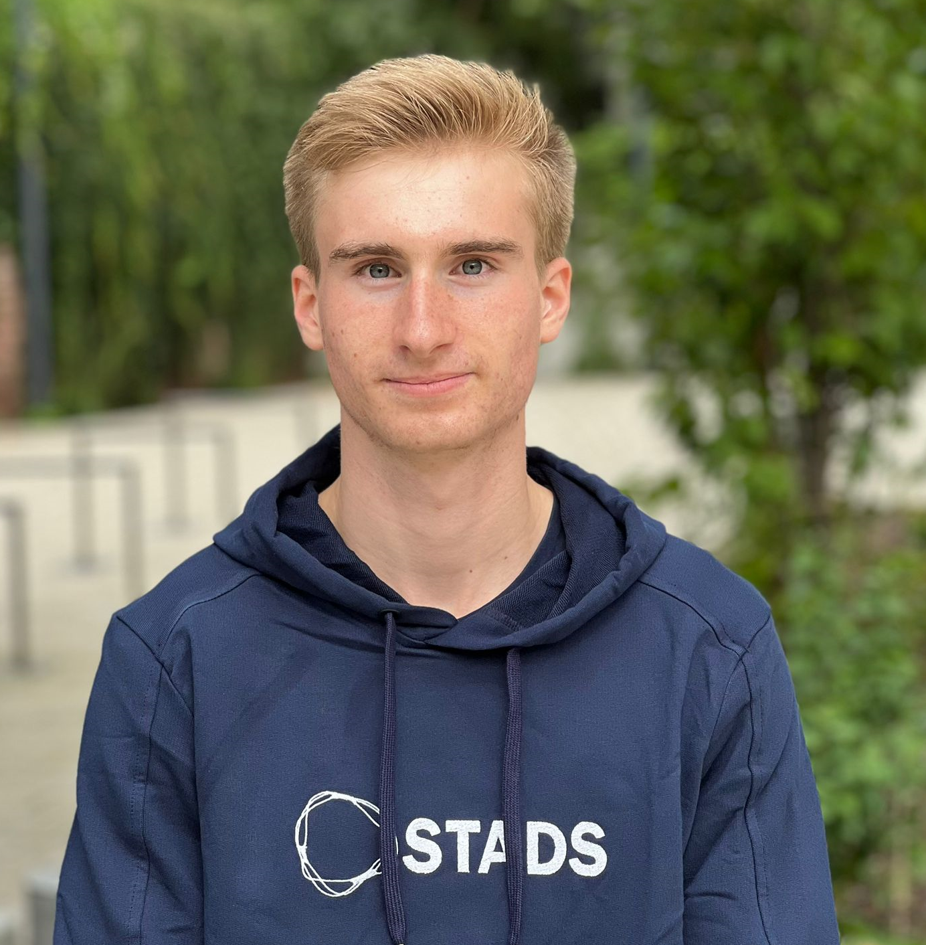
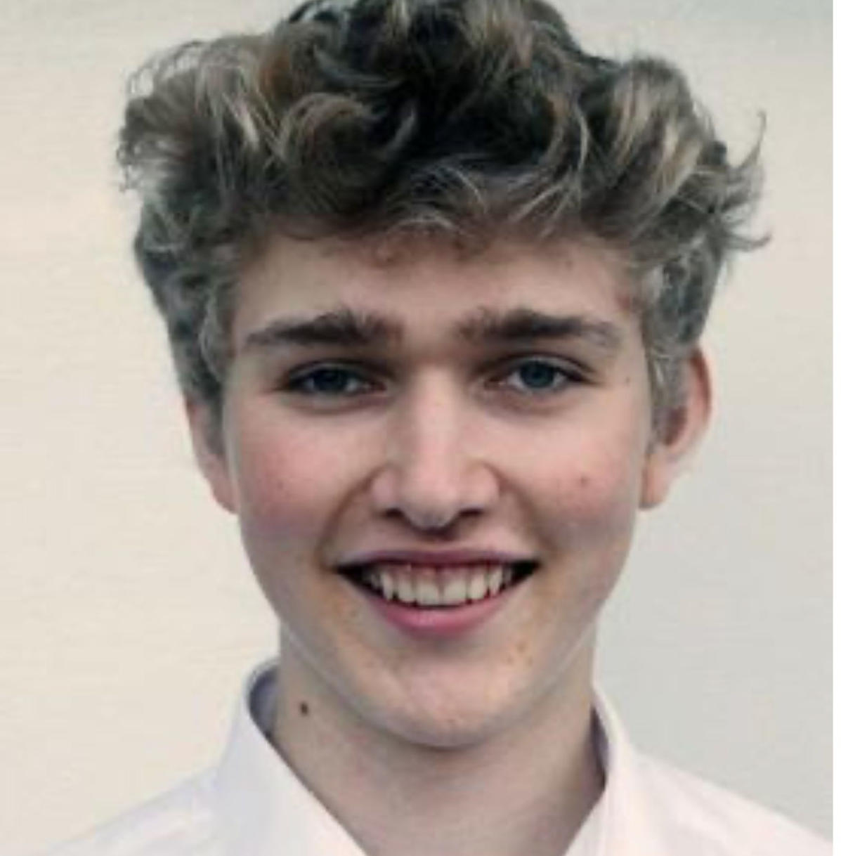

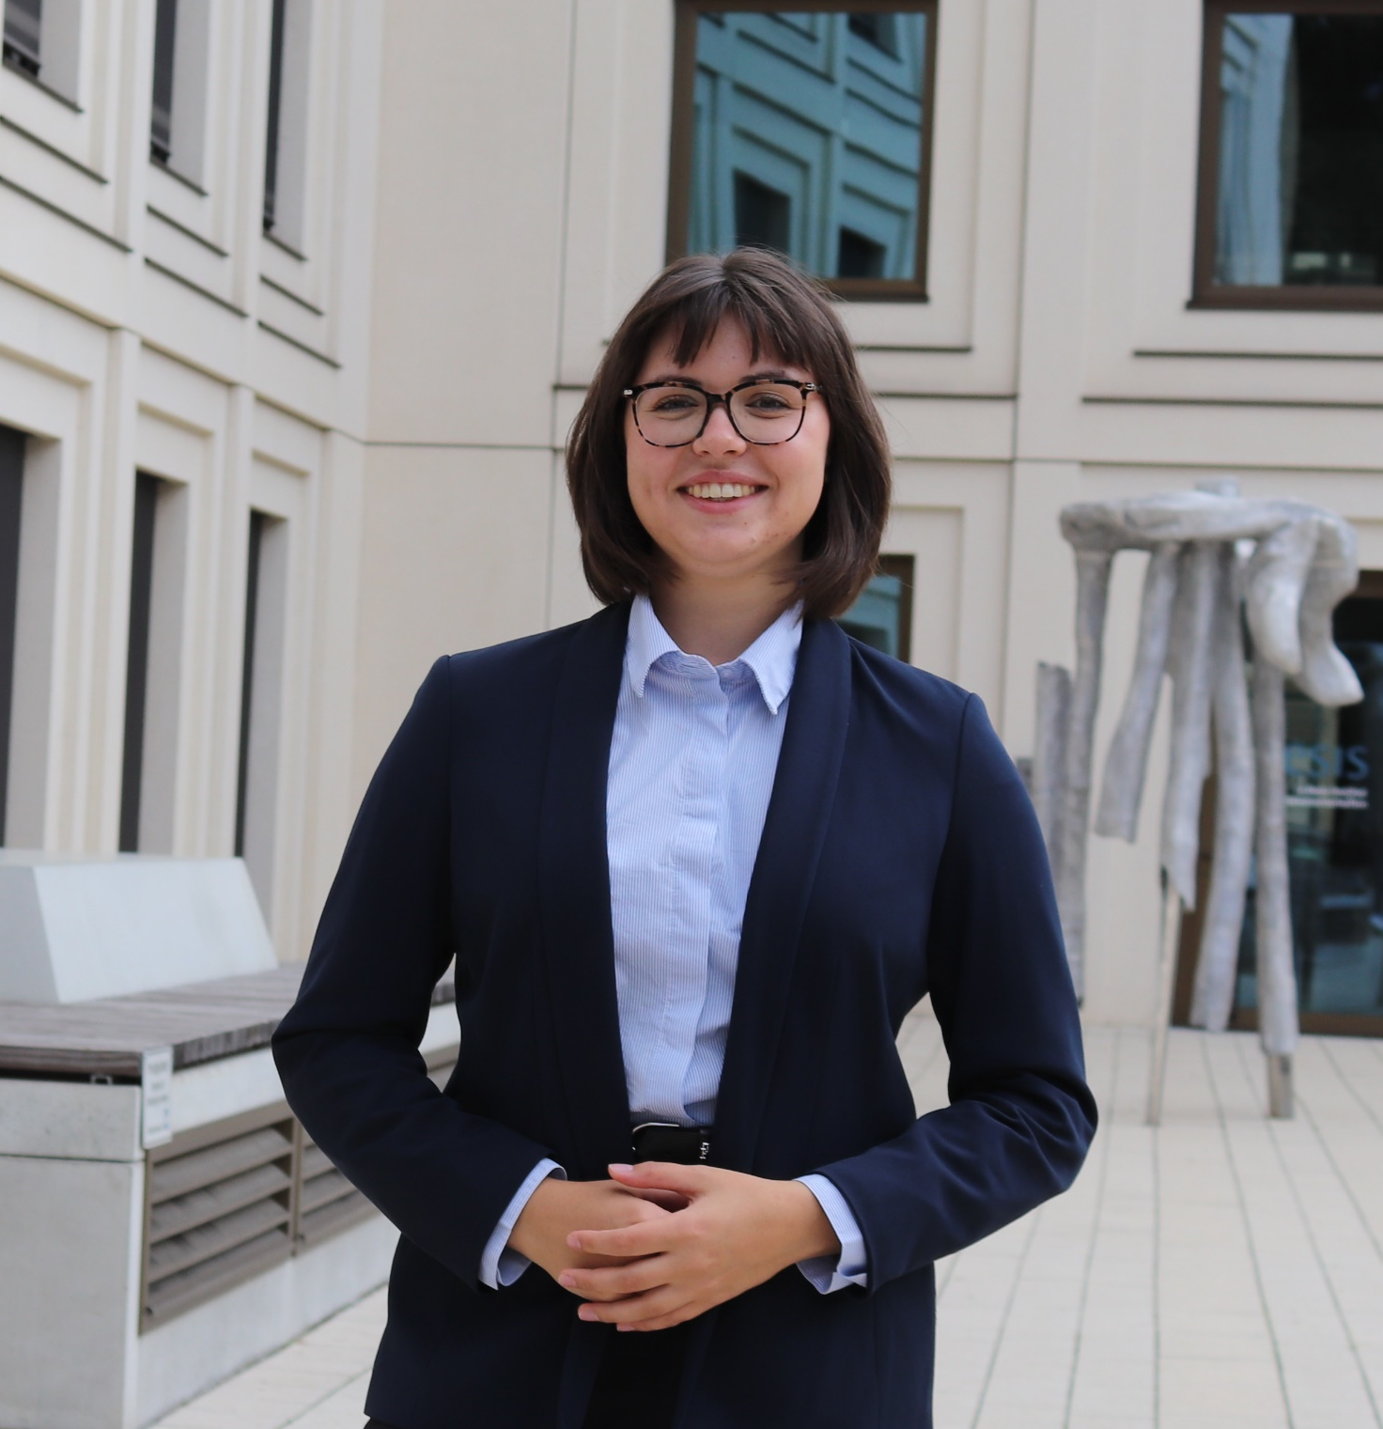
Our Team
Simon Schumacher
Emil Schallwig
Paul
König
Elise Wolf
Making sure you get your groceries on time!

Slide 3
Agenda
Challenge
Approach
Our Solution
Notes:
In order to improve InnoExchange adoption, company appointed specially trained users - key users. Let's see how this measure affected the usage of the software.

Slide 4
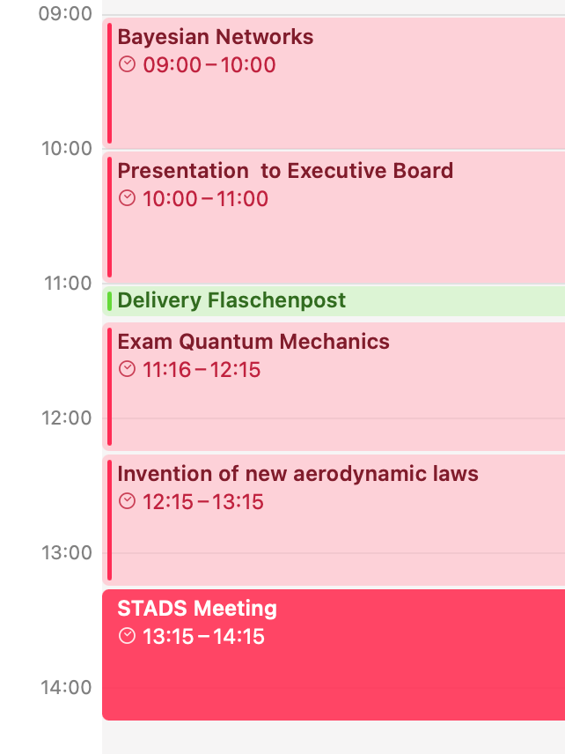
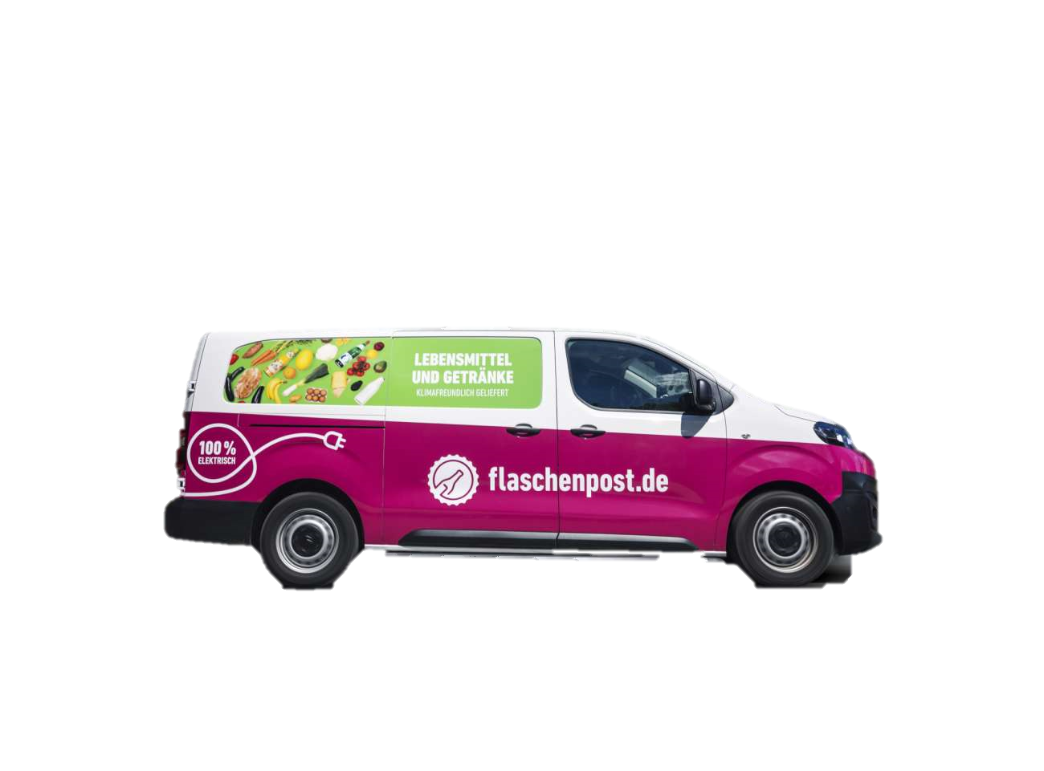

Flaschenpost’s Business Model
Expectation
A typical day in our lives...

Slide 5


Motivation
WHY
Service Time
Too low
Customer Dissatisfaction
Too high
Loss of Efficiency

Slide 6
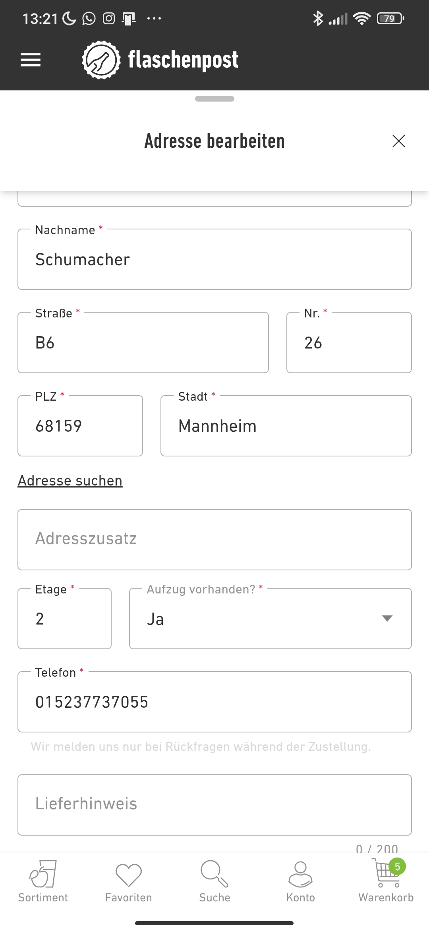
Data on hand
What We Got
Number of stories
Existence of an elevator
Business order
Weight of the items
Arrival time of the driver
Flaschenpost Warehouse
Driver ID
Customer ID
Datathon 25 – Flaschenpost Challenge

Slide 7
Agenda
Challenge
Approach
Our Solution
Notes:
In order to improve InnoExchange adoption, company appointed specially trained users - key users. Let's see how this measure affected the usage of the software.

Slide 8


Feature Engineering
The Approach
Preprocess available
features…
… aggregate information …
… and extract new features.

Slide 9
Enhancing data through Business Understanding
The Approach
Experience of the drivers
Number of crates and boxes to be delivered
Worker's growing fatigue
Recurring customers
Removing outliers

Slide 10
Enhancing data through Business Understanding
The Approach
Experience of the drivers
Number of crates and boxes to be delivered
Worker's growing fatigue
Recurring customers
Removing outliers

Slide 11
Enhancing data through Business Understanding
The Approach
Experience of the drivers
Number of crates and boxes to be delivered
Worker's growing fatigue
Recurring customers
Removing outliers

Slide 12
Enhancing data through Business Understanding
The Approach
Experience of the drivers
Number of crates and boxes to be delivered
Worker's growing fatigue
Recurring customers
Removing outliers

Slide 13
Enhancing data through Business Understanding
The Approach
Experience of the drivers
Number of crates and boxes to be delivered
Worker's growing fatigue
Recurring customers
Removing outliers

Slide 14
Challenge
Approach
Our Solution

Slide 15




Our Models
The challenge
We experimented with a diverse set of models...
Linear Regression
Random Forest
XGBoost
BART
LinexXGB
LightGBM
Deep Gaussian Process
HierarchicalBayes
Neural Network
Bayesian Ridge Regression
MAE
MSE
R2
Confidence Interval
Shared Datasets
Streamlined
preprocessing…
… applied to different models …
… and shared evaluation.

Slide 16
Our Results
The challenge
… that achieved similarly low MAE values - substantially outperforming our baseline predictions.”
Model | MSE | MAE | R2 | Confidence Interval
Baseline | 36.965 | 4.330 | -- | (-9.801; 9.801)
XGBoost | 11.299 | 2.316 | 0.769 | (-9.759, 9.787)
Neural Network | 26.658 | 3.5201 | 0.279 | (-9.469, 9.493)
Bayesian Ridge Regression | 26.932 | 3.579 | 0.271 | (-9.714, 9.738)
Linear Regression | 26.995 | 3.582 | 0.270 | (-9.718, 9.742)
LightGBM | 133.025 | 9.801 | -2.599 | (9.777; 9.824)

Slide 17
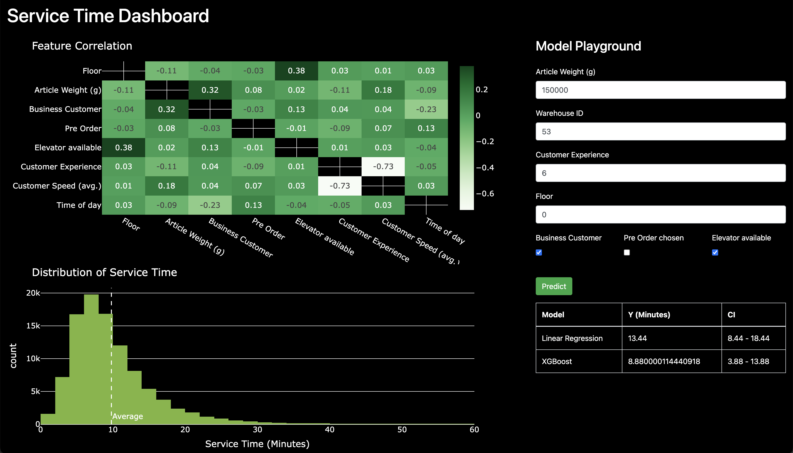
Service Time Dashboard
Our solution
We help the Flaschenpost experts by providing them with all information at hand…

Slide 18



Next Steps
Wrap up
New Features based on additional Data
Integrate additional or external data (e.g., weather, traffic) to derive novel features that boost model performance.
Value Analysis of Customers
Quantify customer value by analyzing historical behaviors to drive targeted retention strategies.
Anomaly Detection of Drivers
Identify unusual driver performance through advanced anomaly detection to mitigate risks.

